Slide 1
Excretory system
Name: Akshara.Rohit.Patel
STD: 10th G
Roll No: 4
Subject: Science PPT
Guided By: Mrs Khayati Mam

Slide 2
Introduction
01
02
03
Excretion is the biological process of removal of metabolic wastes.
Organs involved form the Excretory System.
Main Waste Products: Urea, uric acid, excess salts, water

Slide 3
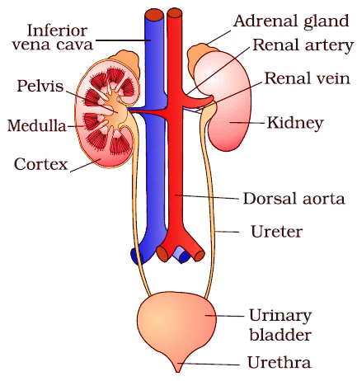
Human Excretory System
01
02
Kidneys
Ureters
03
04
Urinary
Bladder
Urethra

Slide 4
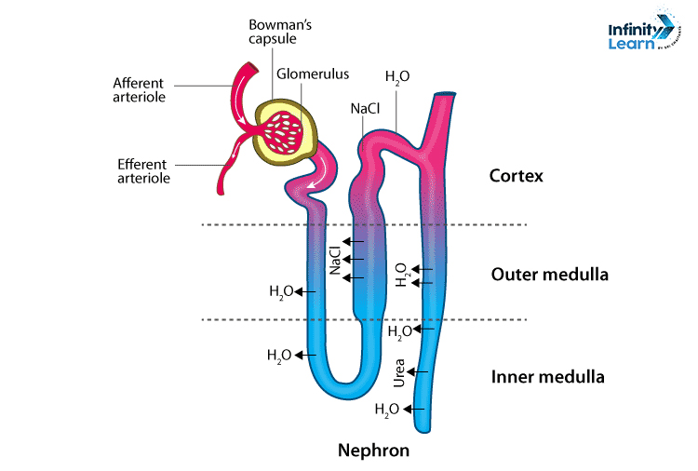
Nephron – Functional Unit
01
1 million nephrons per kidney
02
Parts: Bowman's Capsule, Glomerulus, Tubule, Collecting duct
03
Function: Filtration, reabsorption, secretion
04
Excretion: urine containing waste is excreted from the body
05
Nephrons are essential for regulating blood volume, blood pressure etc..

Slide 5
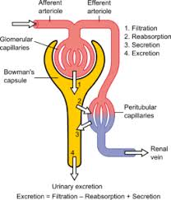
Urine Formation
01
3 Steps:
02
1. Filtration – in glomerulus
03
2. Reabsorption – in tubules
04
3. Secretion – waste secreted into tubules
05
Fact: Average adult excretes 1.5 liters of urine/day

Slide 6
Role of Other Organs in Excretion
01
Lungs: Remove CO₂ during respiration
02
Skin: Removes salts and water via sweat
03
Liver: Converts toxic ammonia to urea

Slide 7
Disorders of Excretory System
01
02
03
Kidney stones
Urinary tract infection (UTI)
Kidney failure – may require Dialysis

Slide 8
Thank You

